Slide 1
Fundamentals of Information Technology
S.S.NACHIYA
DEPT., OF C.S.,

Slide 2
Spreadsheets
A spreadsheet or worksheet is a file made of rows and columns that help sort, organize, and arrange data efficiently, and calculate numerical data.
A collection of spreadsheets is known as a workbook. Every Excel file is called a workbook.
Typical Uses For Spreadsheets:
~ Budgets ~ Financial/Accounting Reports ~ Taxes ~ Students' Grades ~ Columns of Text ~ Graphs

Slide 3
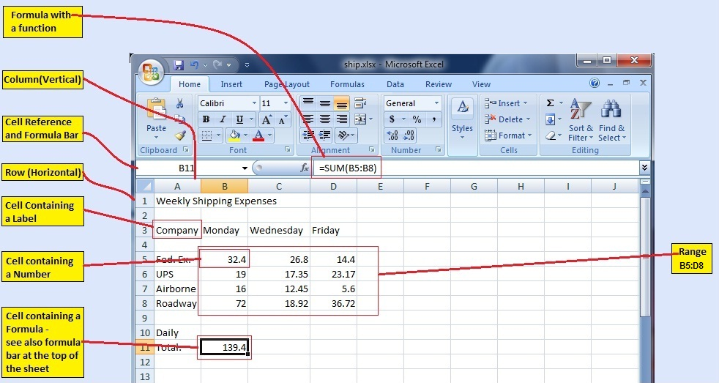
Components of Spreadsheets
The basic components of spreadsheets are:

Slide 4
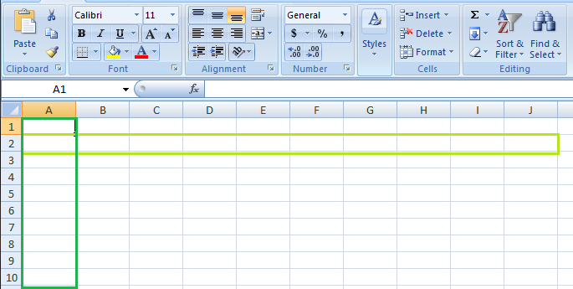
Feature of spreadsheet
1. Rows and columns: Rows and columns are two distinct features in a spreadsheet that come together to make a cell, a range, or a table. In general, columns are the vertical portion of an excel worksheet, and there can be 256 of them in a worksheet, whereas rows are the horizontal portion, and there can be 1048576 of them.

Slide 5
2. Formulas:
In spreadsheets, formulas process data automatically.
It takes data from the specified area of the spreadsheet as input then processes that data, and then displays the output into the new area of the spreadsheet according to where the formula is written. In Excel, we can use formulas simply by typing “=Formula Name(Arguments)” to use predefined Excel formulas.
Some of the commonly used formulas are:
=SUM(Arg1: Arg2): It is used to find the sum of all the numeric data specified in the given range of numbers.
=COUNT(Arg1: Arg2): It is used to count all the number of cells(it will count only number) specified in the given range of numbers.
=MAX(Arg1: Arg2): It is used to find the maximum number from the given range of numbers.
=MIN(Arg1: Arg2): It is used to find the minimum number from the given range of numbers.
=TODAY(): It is used to find today’s date.
=SQRT(Arg1): It is used to find the square root of the specified cell.

Slide 6
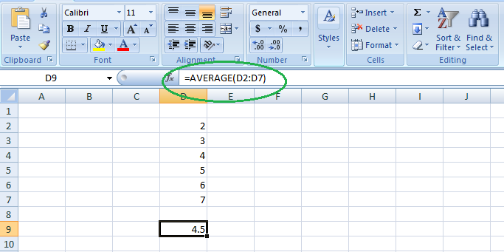
For example, you can use the formula to find the average of the integers in column C from row 2 to row 7:
=AVERAGE((D2:D7)

Slide 7
3. Function:
In spreadsheets, the function uses a specified formula on the input and generates output. Or in other words, functions are created to perform complicated math problems in spreadsheets without using actual formulas. For example, you want to find the total of the numeric data present in the column then use the SUM function instead of adding all the values present in the column.
4. Text Manipulation: The spreadsheet provides various types of commands to manipulate the data present in it.
5. Pivot Tables: It is the most commonly used feature of the spreadsheet. Using this table users can organize, group, total, or sort data using the toolbar. Or in other words, pivot tables are used to summarize lots of data. It converts tons of data into a few rows and columns.

Slide 8

4. Column Header
As you can see, each column has its own heading with alphabet characters representing each column separately.

Slide 9
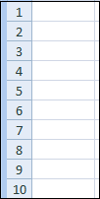
5. Row Header
Alphabets represent column headers, and similarly, row headers are represented by numbers starting from 1. In recent versions of Excel, we have more than 1 million rows.

Slide 10
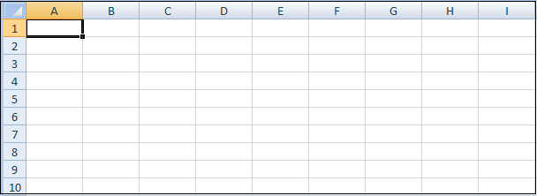
6. Spreadsheet Area
By default, the work area is a grid. This is where we do the work. The combination of column and row forms a cell, i.e., a rectangular box.
Each cell was identified by a unique cell address consisting of a column header followed by a row header. For the first cell, the column header is A, and the row header is 1, so the first cell address is A1.

Slide 11

7. Sheet Tabs
This is where you can find the different sheets in your workbook. Each sheet gets its own tab, which you can name yourself. These can be useful to separate data so that one sheet doesn't get too vast.
For example, you might have an annual budget, where each month is a column, and each row is a type of expense. Instead of keeping it every single year, you track it on one sheet and scroll horizontally. You can make each tab a different year containing 12 months only.

Slide 12
How to Create Spreadsheet in Excel?
Step 1: Open MS Excel.
Step 2: Go to Menu and select New >> click on the Blank workbook to create a simple worksheet.
OR – Press Ctrl + N: To create a new spreadsheet.
Step 3: By default, Sheet1 will be created as a worksheet in the spreadsheet. The name of the spreadsheet will be given as Book1 if you are opening it for the first time.
Create a workbook from a template
Select File > New.
Double-click a template.
Click and start typing.

Slide 13
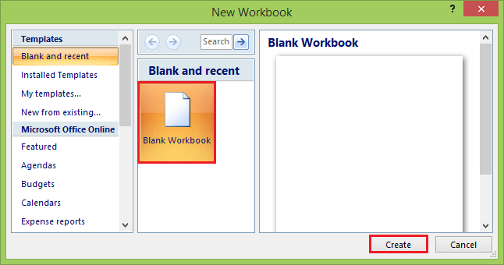

Slide 14
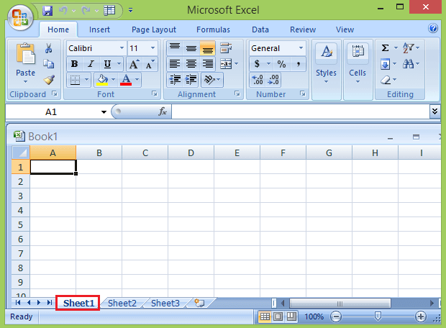
Or you can use the shortcut key, press Ctrl + N to create a new workbook or Spreadsheet.
Step 4: A workbook is the name of the document that contains your spreadsheets.
Step 5: This creates a blank spreadsheet called Sheet1, which you'll see on the tab at the bottom of the sheet.

